Slide 1



RetireWise AI
June 11, 2025
RetireWise AI
Making Retirement Decisions Clearer & Smarter
Presented by :
AI-Powered WealthTech Platform

Slide 2



RetireWise AI
June 11, 2025
Savings Gap
Hidden Risks
Large retirement savings but no clear sustainable spending plan. Inflation erodes purchasing power silently. Market downturns can devastate poorly structured portfolios at the worst possible time.
Unexpected medical and emergency expenses strike without warning. Retirees struggle to judge their own risk tolerance and capacity for loss. Most people cannot assess whether their retirement is truly financially sustainable.
The Problem
Retirees face a critical decision gap: accumulating a lump sum is only the beginning. Without clear, personalised guidance, even large savings can be depleted too quickly — leaving retirees financially vulnerable exactly when they can least afford it.

Slide 3
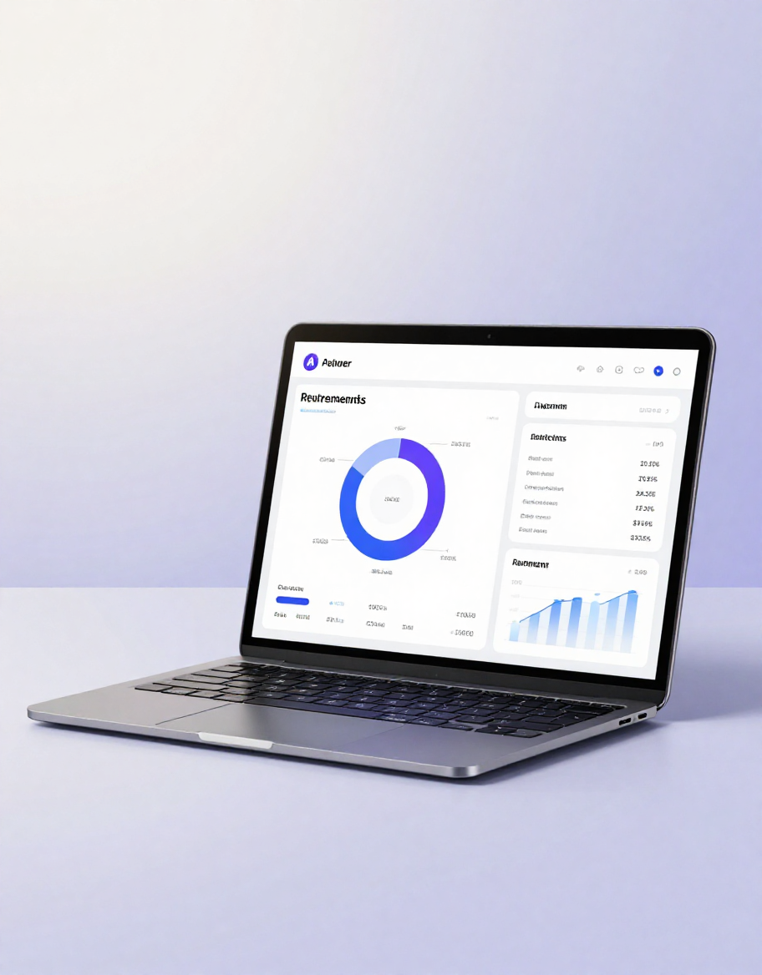
RetireWise AI
June 11, 2025
Assessment & Risk
AI Insights & Reports
RetireWise AI transforms raw financial data into clear retirement decisions. Users input assets, income, expenses, and liabilities to receive a full financial assessment. The platform evaluates risk tolerance, capacity for loss, and long-term retirement sustainability — giving retirees and advisers a structured, reliable foundation for planning.
Powered by an intelligent AI explanation layer, RetireWise AI runs scenario stress tests across inflation, market downturns, and emergency events. Results are translated into plain-language explanations and downloadable PDF reports — turning complex financial calculations into actionable, understandable guidance.
Our Solution

Slide 4
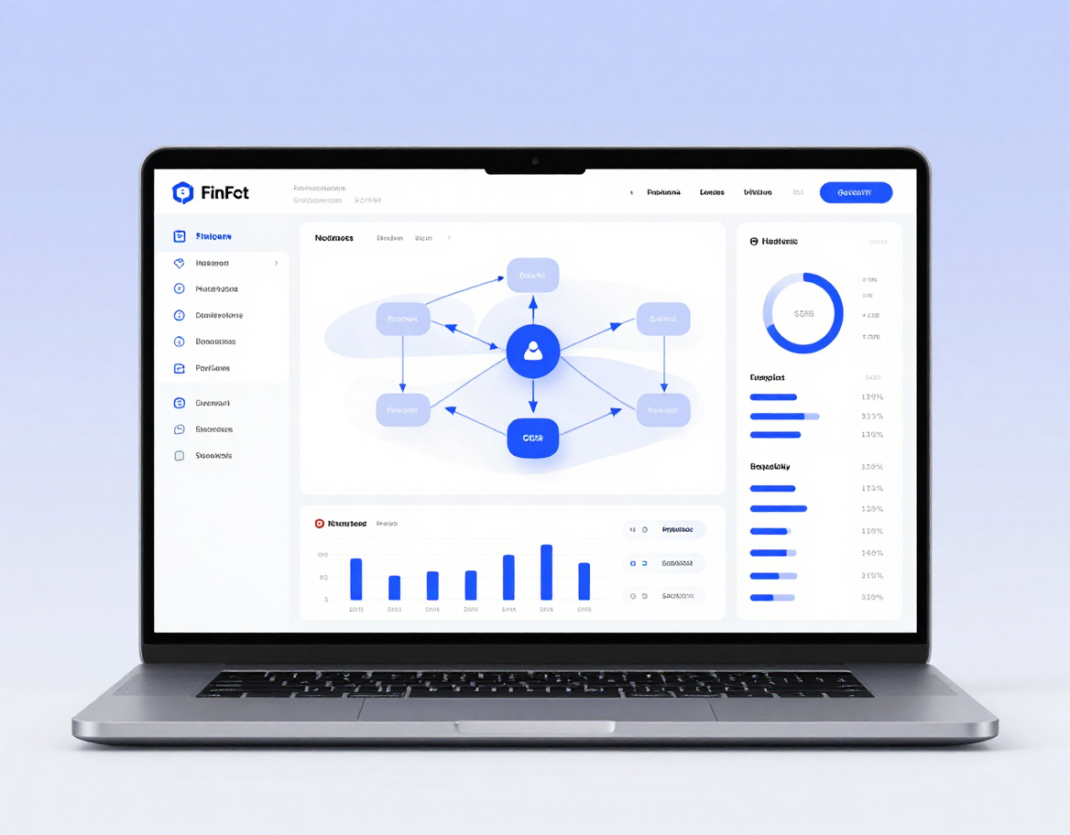
RetireWise AI
June 11, 2025
How It Works
A seamless end-to-end workflow that transforms your financial data into clear, actionable retirement decisions — powered by AI.
Step 1 → 4
Step 5 → 7
User / Adviser inputs data → Financial Assessment (assets, income, expenses, liabilities) → Risk & Capacity Engine (tolerance scoring) → Retirement Calculation Engine (sustainability analysis)
Scenario Stress Testing (inflation, market crash, emergencies) → AI Explanation Layer (plain-language insights via LLM) → Dashboard & PDF Report (visual charts and downloadable summary)

Slide 5

RetireWise AI
June 11, 2025
Technology Stack
Built on credible, modern technologies — RetireWise AI combines a robust financial engine with intelligent AI explanation layers, deployed for real-world reliability and scalability.
Core Platform
AI & Analytics
Python · Streamlit Web UI · Deterministic Financial Engine · PostgreSQL / SQLite Database · Git & GitHub Version Control · Cloud Deployment Infrastructure
Plotly Interactive Charts · LLM API (AI Explanation Layer) · Automated PDF Report Generation · Scenario Stress-Testing Engine · Risk & Capacity Calculation Modules

Slide 6
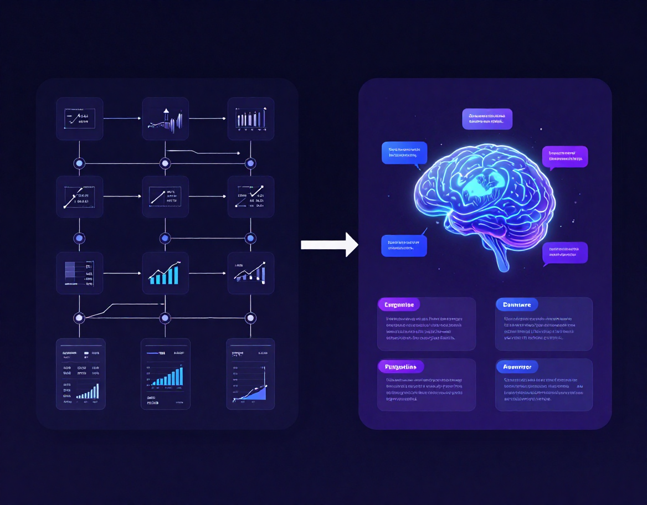
RetireWise AI
June 11, 2025
What Makes It Intelligent?
RetireWise AI combines a deterministic financial engine with a large language model — each playing a distinct, clearly defined role to deliver trustworthy and understandable retirement guidance.
Calculation Layer
AI Explanation Layer
• Deterministic financial engine runs all core calculations
• Risk tolerance & capacity for loss engines process structured inputs
• Scenario stress tests model inflation, market drops & emergencies
• All outputs are precise, rule-based, and fully auditable
• LLM translates complex results into clear, plain-language summaries
• Explains risk scores, sustainability ratings & scenario outcomes
• AI never fabricates numbers or makes unsupported decisions
• Acts as a transparent interpreter — not an autonomous adviser

Slide 7
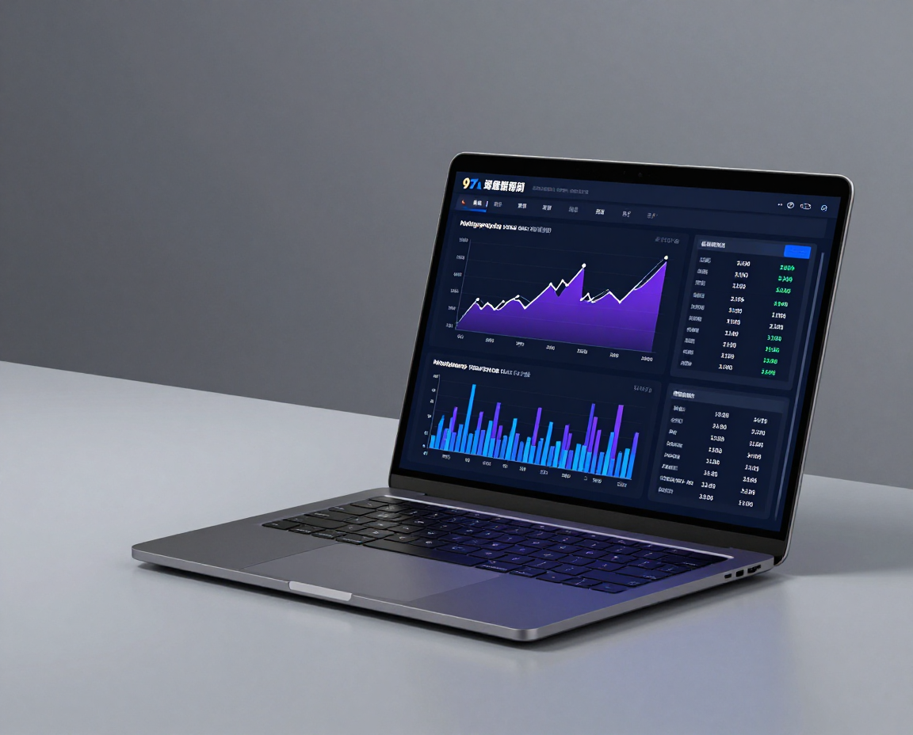
RetireWise AI
Page 7
Setup & Input
Run & Report
  Create a sample retiree profile
  Enter age, assets, income & expenses
  Input liabilities and financial goals
  Run the full financial assessment
  View risk tolerance & capacity for loss
  Test inflation, market & emergency scenarios
  Generate AI plain-language explanation
  Export full PDF report & dashboard
Live Demo
Watch RetireWise AI transform a retiree's financial data into clear, actionable insights — from a blank profile to a full AI-generated PDF report with scenario analysis in minutes.

Slide 8
RetireWise AI
June 11, 2025
Our Team
Syed Hussain Ali Zaidi
Nawab Waqar Boto
Usman Aslam
Aamir Burki
LEADER
MEMBER 1
MEMBER 2
Member 3

Slide 9



RetireWise AI
June 11, 2025
Thank You
Better financial understanding. Smarter retirement decisions. Clearer guidance.
Presented by :
RetireWise AI Team

